Slide 1


GIT-CHECK OUT
Presented By: Mohana sai kumar reddy B
Notes:
Note: First “Right Click” on the Gradient background, go to “Order” option and “Send it to Back”, then insert your picture into “Image Placeholder”, “Right Click” on the picture and again go to “Order” option and “Send it to Back” to get the “Gradient” effect.

Slide 2


Contents:
Git introduction
Why using Git?
Basic Operations of Git.
Introduction to Git checkout command
Implementation of Git checkout (Operations).

Slide 3

Introduction to Git
Created by Linus Torvalds, April 2005.
Replacement for BitKeeper to manage Linux kernel changes.
A command line version control program.
uses checksums to ensure data integrity.
distributed version control (like BitKeeper).
cross-platform (including Windows!).
open source, free.

Slide 4
Why using Git?
No need to connect to central server.
Can work without internet connection.
Developers can work independently and merge their work later.
Every copy of a Git repository can serve either as the server or as a client (and has complete history!).
Git tracks changes, not versions.
Anyone wanting to track edits (especially changes to text files) - review history of changes - anyone wanting to share, merge changes.

Slide 5
Basic Operations of Git:
git add - Puts current working files into the stage.
git checkout - Replaces the current working files with files from a branch.
git clone - Clone an existing repository into a new directory.
git commit - Commits staged changes to a local branch
git fetch - Downloads changes from a remote repository into the local clone.
git merge - Merges files from a given branch into the current branch.
git pull - Fetches remote changes on the current branch into the local clone, and merges them into the current working files..
git push - Uploads changes from all local branches to the respective remote repositories.
git reset - Makes the current branch point to some specific revision or branch..

Slide 6
Introduction to Git checkout :
Git checkout tells Git which branch or commit to apply your new changes.
Git checkout is great for getting to work with branches, it is also useful for reviewing old commits since it switches the version of your repository to this older snapshot.
The git checkout command operates upon three distinct entities: files, commits, and branches.

Slide 7
Switch to <branch> to prepare for working on it by updating the index and files in the working tree, as well as directing HEAD at the branch. Local changes to the working tree's files are saved so that they can be committed to the <branch>.

Slide 8
Implementation :
Created a directory and changed the directory to root directory.
Creating an empty repository using git init command.
Added a file Assignment.txt in the root directory i.e ‘assignment1’
Committed the file and pushed it to the git repository using git remote add origin(a commit is a snapshot of your repository at a certain point in time).
The created files were sent to ‘master’ branch.
Created a new Branch named ‘test’ using ‘git branch test’
In order to switch to the branch ‘test’ used ‘git checkout test’
Created a new file for branch test ‘newbranch.txt’
Checked the status of the file to make sure that the files added are committed or not

Slide 9
Implementation :
Added the branch to git account.
made sure that all the commits were done
And all the files were kept in the respected branches.
Following Screenshots are the implementation part.

Slide 10
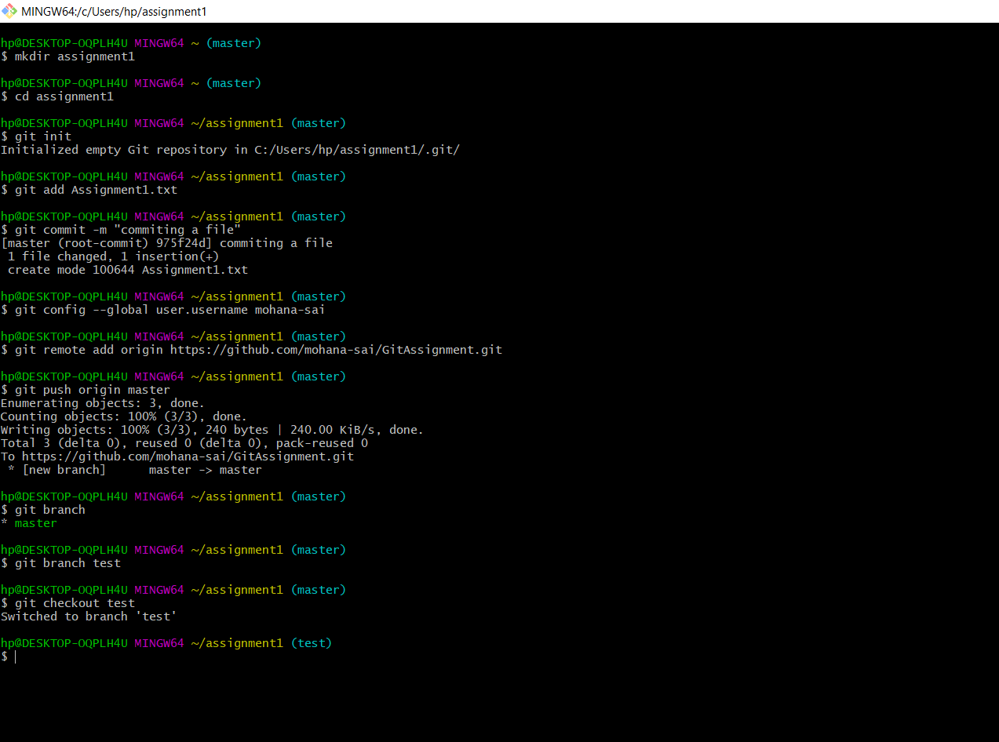

Slide 11
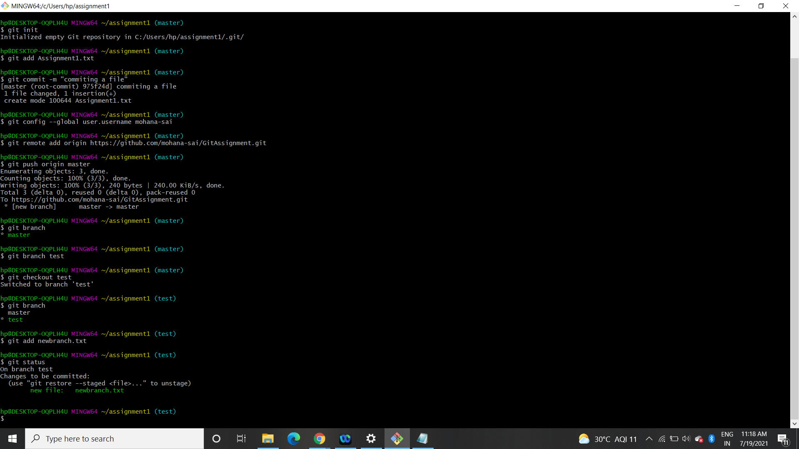

Slide 12
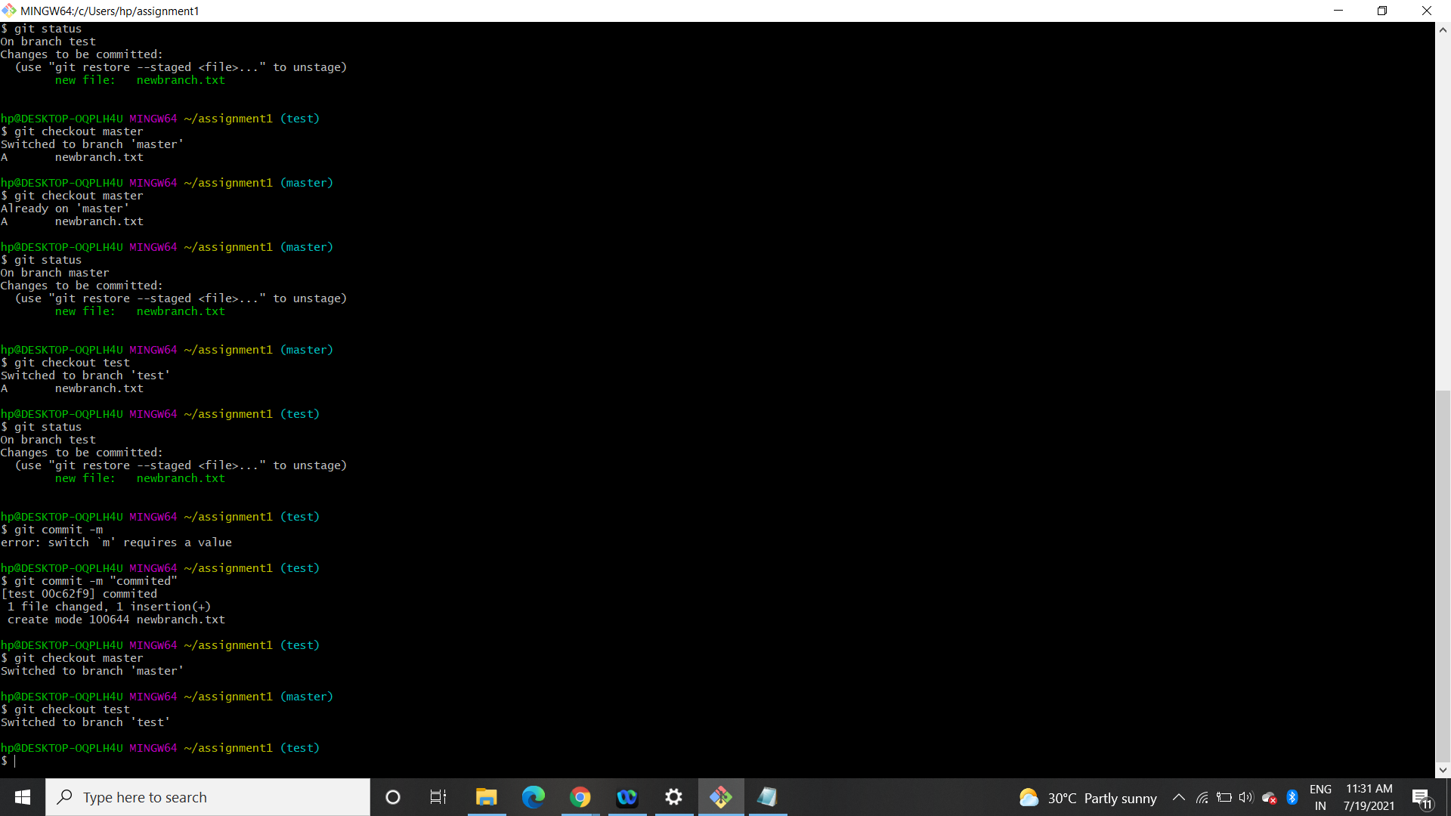

Slide 13
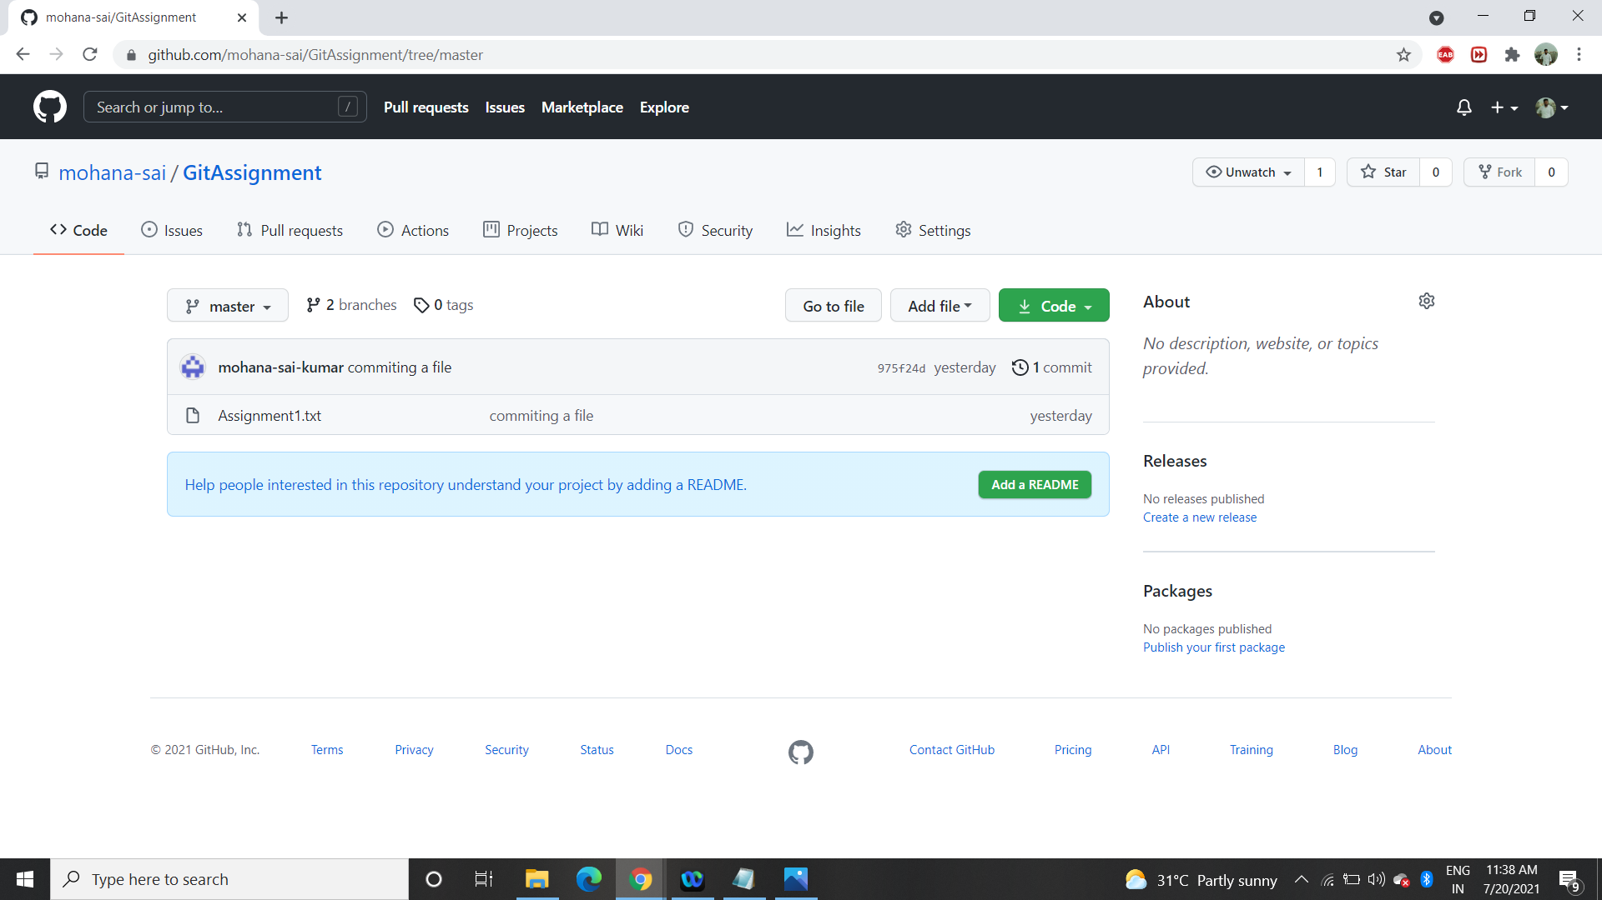
This is of Master branch

Slide 14
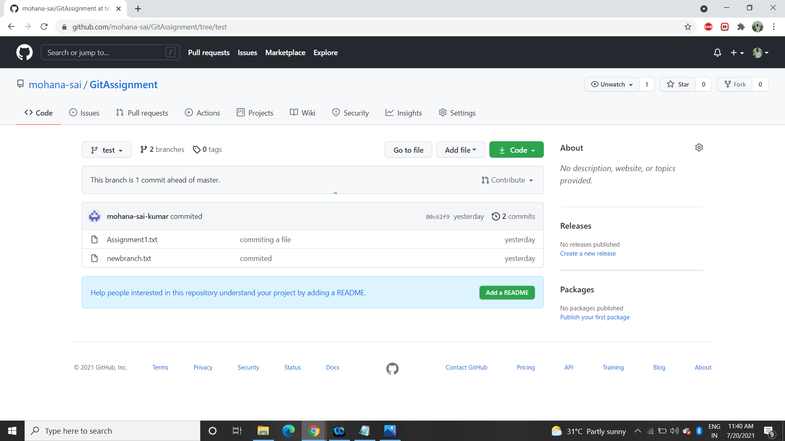
This is of test branch

Slide 15
Overview of Principles done in the PPT:
A branch is just a pointer to 1 specific commit,and a commit is a snapshot of your repository at a certain point in time
The branch pointer moves along with each new commit you make
if you want to make changes on a branch that you don't currently have checked out, you first need to checkout the branch.
Checking out a branch will update your repository files to match the snapshot of whichever commit the branch points to.
From here, the branch pointer will follow each new commit that you make on the branch.
It is also possible to directly checkout a commit which will update your repositories
Git checkout is great for getting to work with branches, it is also useful for reviewing old commits since it switches the version of your repository to this older snapshot

Slide 16
Link for Github where the files were pushed :
https://github.com/mohana-sai/GitAssignment

Slide 17
Thank You !

